Slide 1
going the EAZY way: new EQW calculations for 3d-hst
Rohan Naidu
rohan.naidu@yale-nus.edu.sg

Slide 2
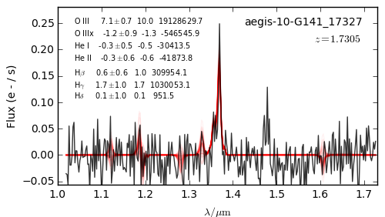
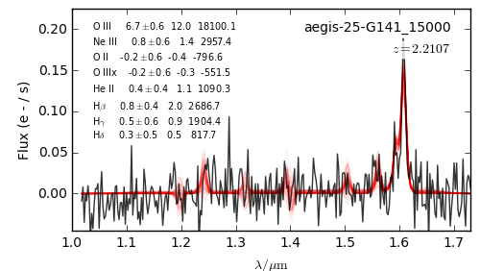
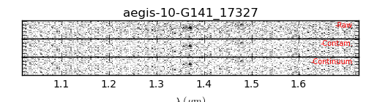
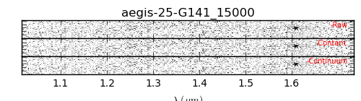
the problem
Objects with 5σ detections of OIII-line flux with uncontaminated spectra have unreasonably high observed OIII-EQW according to existing 3D-HST catalogues (objects pictured have OIII_EQW 19128629.7Å and 18100.1Å). For comparison, some of the largest reported rest-frame OIII EQWs are ~3700A (Huang, 2015).

Slide 3
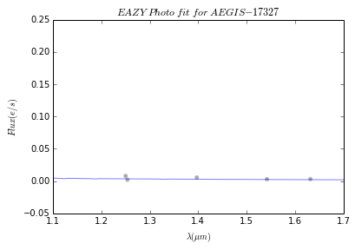
our solution
We use photometric data via EAZY to calculate the continuum level and use it to find EQW.
EQW = (OIII flux from catalogue)/(average continuum level in a 100Å
window around the OIII line)
For aegis-10-G141-17327:
EQW = (7.12)/(0.002935) = 2425Å (versus 191286297Å from the catalogue)

Slide 4
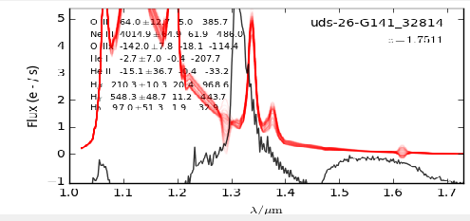
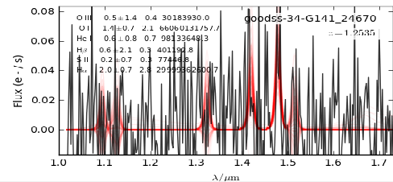
Objects from all fields with 5σ detection in F140W, 5σ OIII line flux, use_phot==1
OIII Rest frame EQW | Number of objects in catalogue | Number of objects in our new reduction
>10000 A (no such objects in existing literature) | 492 (most of these objects have clear spectra) | 15 (all these objects have very bad spectra)
>4000A (no such objects in existing literature) | 632 | 28 (every single one of these objects has very bad spectra)
>1000 A | 1239 | 242
>500 A | 1976 | 1244 (at lower EQWs, the methods converge—see next slide)

Slide 5
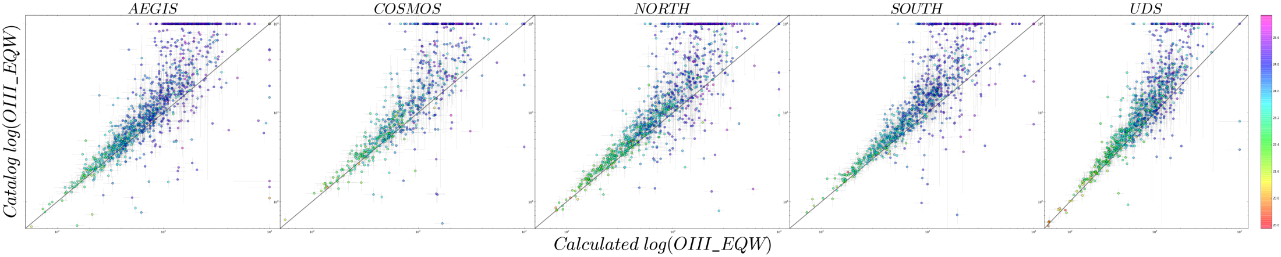
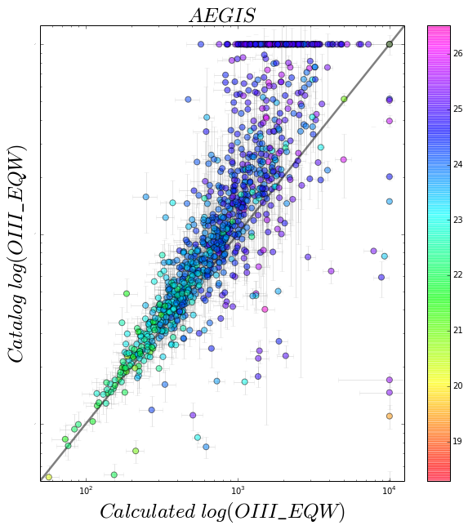
catalog_eqw vs new_eqw for all objects with lines
In all graphs, EQW>10,000 is plotted as EQW==10,000. The new calculation agrees well with the catalogue for low EQWs (Observed EQW~<2000). For what are the higher EQWs according to the catalogue, we see a sharp divergence--the new calculation gives lower values. The extreme outliers on the right (Calculated EQW=10,000) are the same bad spectra discussed in the previous slide.

